Slide 1
Inclusive Language Commitment
Arm is committed to making the language we use inclusive, meaningful, and respectful. Our goal is to remove and replace non-inclusive language from our vocabulary to reflect our values and represent our global ecosystem.
Arm is working actively with our partners, standards bodies, and the wider ecosystem to adopt a consistent approach to the use of inclusive language and to eradicate and replace offensive terms. We recognise that this will take time. This course may contain references to non-inclusive language; it will be updated with newer terms as those terms are agreed and ratified with the wider community. We recognise that some of you will be accustomed to using the previous terms and may not immediately recognise their replacements. Please refer to the following examples:
When introducing the AMBA AXI Protocols, we will use the term ‘Manager’ instead of ‘Master’ and ‘Subordinate’ instead of ‘Slave’.
When introducing the architecture, we will use the term ‘Requester’ instead of ‘Master’ and ‘Completer’ instead of ‘Slave’.
Contact us at education@arm.com with questions or comments about this course. You can also report non-inclusive and offensive terminology usage in Arm content at terms@arm.com.

Slide 2
Introduction to Arm-based System on Chip Design

Slide 3
Learning Outcomes
At the end of this module, you will be able to:
Explain the motivations for the development of a System on Chip (SoC).
Define what an SoC is and its characteristics.
Outline the advantages and limitations of SoCs.
Describe the main steps in an SoC design flow.
Define what a Programmable SoC (PSoC) and its characteristics.

Slide 4
Why the SoC Design Concept Developed
We are living in a post-PC era, with:
Smartphones and tablets
The Internet of Things, wearable computing, and cyber-physical systems
Industry 4.0
The silicon transistor is still at the heart of this revolution.
The primary metrics of silicon chips have changed: from clock-frequency to cost, form-factor, and power.
On-chip integration of functional hardware is now more important than ever.
How and why have we reached this point?
Notes:
We will begin this lecture with an overview of the Development of the SoC Design Concept.
Smartphones and tablets, wearable computers, and massively interconnected devices are being integrated into everything and are becoming everyday life objects. Mobility and autonomy are now as important as performance in modern electronic devices.
Modern electronic devices today demand on-chip integration of hardware that achieves low cost and low power with good performance.
In the following slides, we will look at how and why SoCs came into development.

Slide 5
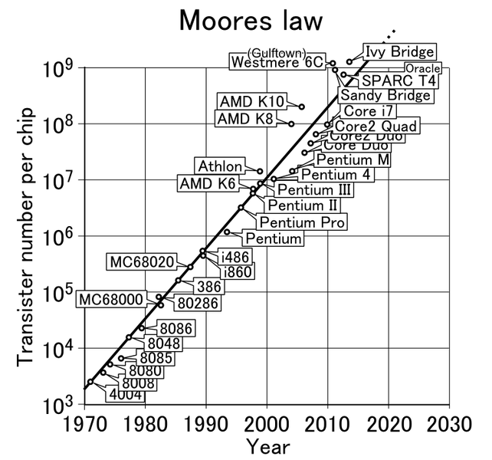
Moore’s Law
Moore’s Law
Prediction of Moore’s Law^{(*)}
(*) Data are based on international semiconductor technology road map (http://www.itrs.net/)
Notes:
In 1965, Intel co-founder Gordon E. Moore made an important observation famously known as Moore’s Law.
Moore stated that the number of transistors on an integrated circuit for a minimum component cost doubles every two years.
Moore’s predictions have been proven to be correct and they are still considered as one of the main driving forces in the development of semiconductor technologies.
As can be seen from this figure, the number of transistors integrated on one chip has already crossed the one billion mark.

Slide 6
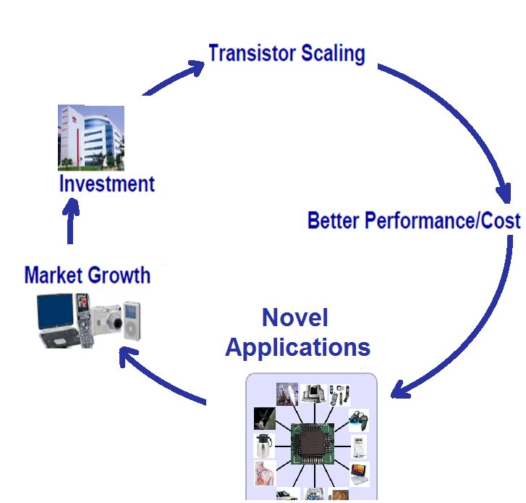
Why Scaling?
The virtuous circle of the semiconductor industry
Notes:
What has driven the semiconductor industry to double the number of transistors on a chip every two years? The short answer is money.
In fact, in order to maintain this trend, the semiconductor technology has to shrink in size by a factor of 0.7 with every generation.
This is known as scaling, and it means that, with every generation, one can integrate twice as many functions per chip.
The chip fabrication itself does not increase significantly. This essentially means that the cost of a function decreases by a factor of 2. Reducing the fabrication costs per function makes it feasible to design more sophisticated systems on a chip, which have enhanced performance.
This diagram shows the virtuous circle of the semiconductor industry that has been going on for more than fifty years.
The continuous development of better performance and cheaper semiconductor chips has led to the proliferation of these technologies in all corners of modern life. Nowadays, you can find semiconductor chips everywhere: in mobile phones, TVs, home appliances, cars, children’s toys, and even in the human body such as pacemakers.
This widespread use of the applications of semiconductor technologies leads to market growth. This lucrative industry reached the $250 billion mark by the year 2000. Some of this profit is typically used to develop new semiconductor devices that are smaller in size and cheaper in price. This, in turn, leads to the creation of more novel applications and more number of users, hence generating more profit.

Slide 7
The Design Productivity Gap
Complexity outpaces design productivity
Notes:
But how can we design chips with more functions? The design engineering population does not double every two years.
In this figure, the x-axis shows progression in time. There are two y-axes:
-The first y-axis on the left of the graph shows the rate of growth in chip complexity. This is measured by the number of transistors per chip.
-The second y-axis on the right of the graph shows the designer productivity. This is measured by the average number of transistors designed by a staff engineer in a month.
The growth of design complexity outpaces design productivity. This is known as the design productivity gap.

Slide 8
Bridging the Design Productivity Gap
Several strategies exist to reduce the design productivity gap exist, namely:
Design Abstraction
Standard
Tools and Hardware Platforms
Design Automation
SoCs
Design Reuse
Fast Prototyping
Notes:
How can we bridge the design productivity gap? To do this, we need to improve the productivity of IC design engineers in order to speed up the development time of systems. In fact, there are several strategies to improve the productivity of design engineers, which include
Design Abstraction
Design Automation
Fast Prototyping
Design Reuse
Standard Tools and Hardware Platforms.
Let’s go through each strategy, starting with Design Abstraction.
Design Abstraction allows the elevation of the design process for architects to the system level. This means that early design decisions, exploration, and platform decisions are made above the traditional logic or Register Transfer Level (RTL). Design Abstraction therefore speeds up the design process.
Next, Design Automation improves design productivity by automating some of the design tasks with the help of IC design tools.
Fast Prototyping is also an important strategy. SoC designs can be prototyped on FPGA for quicker verification of hardware, firmware, and application software functionalities.
In addition, Design Reuse is a good strategy. Design productivity can be enhanced by increasing the granularity of design library elements from standard cells to hardware and software complex functional blocks. Some examples are custom accelerator and processor core.
Finally, Standardized tools and hardware platforms are crucial to allow quick prototyping of systems for evaluation and testing.

Slide 9
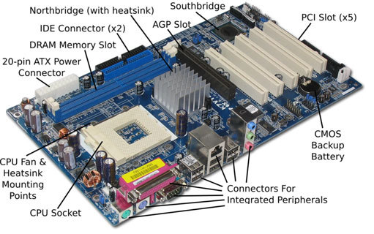
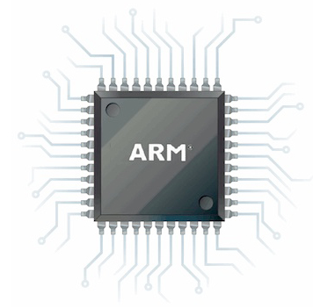
What Is an SoC?
An SoC is an integrated circuit that packages basic computing components into a single chip.
An SoC may have most or even all of the components to power a computer.
Arm cores
arm
AMBA buses
Physical IPs
Motherboard of a PC
SoC
Picture source: http://thecustomizewindows.com/, http://www.adafruit.com/
Notes:
The application of the previous strategies, especially design abstraction, has led to the development of the idea of the SoC design framework.
What is an SoC? It is an integrated circuit designed by combining pre-existing blocks, such as cores or other Intellectual Properties (IPs). The aim of the SoC is to provide full functionality for a specific application. In other words, an SoC is a single silicon chip that can be used to implement the functionality of an entire system, rather than using several different physical chips on a board.
The concept of SoC has evolved with the technology. SoCs nowadays are usually referred to a chip containing a general-purpose processor, some embedded memory, application-specific processors or physical IPs, interfacing modules, high-speed logic, and so on. It usually requires buses to efficiently interconnect all these parts.
The figure shown here is an Arm SoC that contains most of the components needed to power a computer. Such components include Arm cores, AMBA buses, and other physical IPs.

Slide 10
What Is Inside an SoC?
The basic components of an SoC include:
A system Requester, such as a microprocessor or DSP
System peripherals, such as memory blocks, timers, and external digital/analog interfaces
A system bus that connects Requester and peripherals using a specific bus protocol
More sophisticated s are integrated in modern SoCs, such as multicores, DSPs, GPUs, and multiple buses connected by bus bridges.
A simple SoC
System Requester
(Processor)
System Bus
Program
Memory
Data
Memory
Timer
DAC
GPIO
Watchdog
Notes:
The basic components of an SoC include a system Requester microprocessor, which is connected to several peripherals through one or various system buses.
Examples of peripherals are memory blocks, DAC/ADC, GPIOs, and so on.
More sophisticated modules are integrated in modern SoCs, such as multicores, DSPs, GPUs, and multiple buses connected by bus bridges.

Slide 11
Example Arm-based SoC
Clock
Generator
Power
Management Unit
Watchdog
JTAG/Serial wire
Arm Cortex-M0
Microprocessor
DMA
Low Latency
AHB IOP
Timers
Mux
APB Bus
AHB to APB
Bus Bridge
UART
ARM AMBA 3 AHB-Lite System Bus
Arm AMBA 3 AHB-Lite System Bus
RAM
System
Control
UART
ROM
VGA
Boot
ROM
RAM
GPIO
ROM
Table
Timer
AHB
Peripheral
7-segment
Display
APB
Peripheral
An example of an Arm-based SoC
Notes:
A basic Arm-based SoC usually consists of:
An Arm processor, such as the Cortex-M0 processor
An Advanced Microcontroller Bus Architecture also known as AMBA. For example, in the diagram shown here, the SoC uses an AMBA 3 System Bus.
Physical IPs or peripherals from Arm or third parties.
Additionally, some SoCs may have a more advanced architecture, such as multi-bus system with bus bridge, DMA engine, and clock and power management.

Slide 12
Advantages of SoCs
SoC
Advantages
Higher performance
Lighter footprint
Power efficiency
Higher reliability
Low cost
Notes:
Compared to conventional systems on boards, the integration of a whole system on a single chip provides numerous advantages.
First of all, one advantage is having higher performance. The dense integration of system blocks on the same chip will reduce the length of wires needed to connect them together. This reduces wire propagation delay, hence improving the whole system performance.
The other advantage is having a Lighter footprint. The device size and weight is reduced as all system blocks are integrated on the same chip.
Power efficiency is also an important advantage. Power efficiency is achieved because the voltage required for SoCs is typically less than 2.0 volts, which is lower compared with external chip voltage needed for systems on boards that are typically more than 3.0 volts. Another reason for power efficiency is the fact that intra-chip wires have less capacitance than inter-chip wires.
SoCs also offer higher reliability. This is mainly due to the fact that all system clocks are encapsulated in a single-chip package. Therefore, it is better protected against interference and noise from the external world.
Finally, low cost is a huge advantage of an SoC. The cost per unit is reduced since a single-chip design can be fabricated in large volumes.

Slide 13
Limitations of SoCs
SoC limitations
Less flexibility
Complexity
Application specific
Notes:
The SoC design framework has a number of limitations, mainly because it is not possible to replace individual blocks in an SoC.
Therefore, you may need to replace the whole chip if there is a faulty sub-circuit.
Moreover, the access to the individual blocks from the chip external pins is very limited.
SoCs do have limitations.
First, SoCs are less flexible. Unlike a PC or a laptop, which allows you to upgrade a single component such as RAM or a graphic card, an SoC cannot be easily upgraded after manufacture.
Second, most SoCs are application-specific. Therefore, they are not easily adapted to other applications.
Finally, the complexity of an SoC design usually requires advanced skills compared with board-level development:
The development of a whole system on a single chip requires the designers to employ a number of different design flows, such as custom design flow, mixed signal design flow, and standard cell design flow.
They also needed to integrate a number of digital and analog blocks on the same die. This can be especially challenging due to inter-blocks interference, which may affect the reliability and performance of the system. For example, digital blocks such as processors usually run on very high frequencies. Some of these high-frequency signals may interfere with the clock generator, which is an analog block, through the silicon substrate. This leads to clock jitter, which may cause timing errors or degraded performance.
SoC is also typically built using cores from different vendors. The integration of these in one system requires a lot of expertise in order to design reliable interfaces.
Furthermore, testing an SoC design is a challenging and complex task. This usually requires a careful integration approach to make sure different blocks communicate correctly together and do not affect each other’s performance and reliability.

Slide 14
SoC v Microcontroller v Processor
SoC
CPU
MCU
Can have a single or multiple processor cores
Is a single processor core
Typically has a single processor core
Has larger memory blocks, a variety of IOs, and other peripherals
Used for general purposes
Has memory blocks, basic IOs, and other basic peripherals
Integrated with more powerful blocks, e.g., GPU, DSP
Capable of running OSs
It needs to be supported with memories and IOs
Mainly used for basic control purposes, such as embedded applications
Mainly used for advanced applications (e.g., smartphones, tablets).
Notes:
It is important at this stage to clarify the differences between SoC, CPU, and a microcontroller, also known as MCU. They are all implemented on a single-chip package but have some differences. This diagram summarizes the comparison of their important features.

Slide 15
Commercialized SoCs
Benefiting from its power efficiency, SoCs have been widely used in mobile devices, such as smartphones, tablets, and digital cameras.
A number of SoCs have been developed by a large ecosystem of design companies:
Snapdragon by Qualcomm
Tegra by Nvidia
OMAP by Texas Instruments
Most mobile SoCs use Arm-based microprocessors since they deliver high performance with less power consumption.
Notes:
SoCs are widely used in today’s modern devices due to its power efficiency.
There are a number of design companies that develop SoCs, such as Qualcomm, Nvidia, Apple, and Texas Instruments.
Most mobile SoCs have an Arm-based microprocessor that provides high performance with low power consumption.

Slide 16
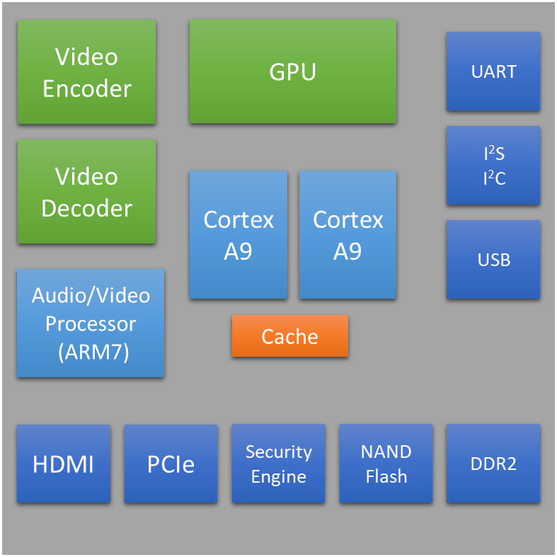
SoC Example: NVIDIA Tegra 2
Designer | NVIDIA
Year | 2010
Processor | Arm Cortex-A9 (dual-core)
Frequency | Up to 1.2 GHz
Memory | 1 GB 667 MHz LP-DDR2
Graphics | ULP GeForce
Process | 40 nm
Package | 12 × 12 mm (Package on Package)
Used in tablets | Acer Iconia Tab A500 Asus Eee Pad Transformer Motorola Xoom Motorola Xoom Family Edition Samsung Galaxy Tab 10.1 Toshiba Thrive
Notes:
An example of a commercialized SoC is the NVIDIA Tegra 2, which is used in a number of tablets such as the Acer Iconia Tab A500 and the Motorola Xoom.
The NVIDIA Tegra 2 is based on the Arm Cortex-A9 dual-core processor. It also incorporates several coprocessing and peripheral units such as a GeForce GPU, a video encoder-decoder, an audio encoder-decoder, an HDMI module, and a cache memory block.

Slide 17
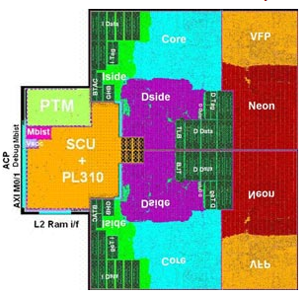
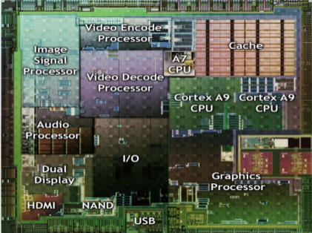
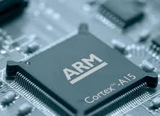

SoC Design Flow
Hardware
IP Cores
Software
Drivers
IP Vendors:
Core Design
Purchase HW cores
Purchase SW drivers
Integrated
Hardware
SoC
Design Specifics
Integrated
Software
HW/SW partitioning
Fabless Vendors: SoC Design
Functional
Simulation
Prototype on Platforms
e.g., FPGA
Software
Simulation
Physical Optimization
and Fabrication
HW/SW
Co-verification
Application Development
and Test
Foundries:
Chip Fabrication
Volume Manufacture
and Ship
Device Vendors:
Final Products
PCB Manufacture
and Device Assembly
Notes:
We shall now look at a typical SoC Design Flow.
In a typical SoC design flow, there is a set of key steps to be undertaken from specification to final packaging.
In reality, the design process is more complicated; it is partly concurrent with iterative loops. IC design tools are also integral to this process.

Slide 18
SoC Design Flow
Hardware
IP Cores
Software
Drivers
IP Vendors:
Core Design
Purchase HW cores
Purchase SW drivers
Integrated
Hardware
SoC
Design Specifics
Integrated
Software
HW/SW partitioning
Fabless Vendors: SoC Design
Functional
Simulation
Prototype on Platforms
e.g., FPGA
Software
Simulation
Physical Optimization
and Fabrication
HW/SW
Co-verification
Application Development
and Test
Foundries:
Chip Fabrication
Volume Manufacture
and Ship
Device Vendors:
Final Products
PCB Manufacture
and Device Assembly
Notes:
The SoC consists of both the hardware and the software that runs on the SoC. Therefore, both hardware and software will need to be considered in the SoC design flow.
The first stage of the design flow is defining the SoC design specification. This includes determining the operation modes of the system, as well as what kind of hardware IPs and software that are required for the SoC to achieve the expected performance. Examples of software used for the SoC include software drivers, Operating System, or other application-specific software modules. The hardware IPs and some software modules can be developed in-house or purchased from third-party vendors.
Once all the necessary hardware IPs have been sourced, the IPs are then integrated together to form the SoC. A functional simulation is also a crucial step to verify that the IPs and the integration of those IPs produce the expected outcome. Likewise, for the software, once the necessary drivers and software modules are sourced, the modules and drivers are combined or integrated. A software simulation is then performed on the integrated software.
After hardware and software simulations have been performed and verified, prototyping can be done.

Slide 19
SoC Design Flow
Hardware
IP Cores
Software
Drivers
IP Vendors:
Core Design
Purchase HW cores
Purchase SW drivers
Integrated
Hardware
SoC
Design Specifics
Integrated
Software
HW/SW partitioning
Fabless Vendors: SoC Design
Functional
Simulation
Prototype on Platforms
e.g., FPGA
Software
Simulation
Physical Optimization
and Fabrication
HW/SW
Co-verification
Application Development
and Test
Foundries:
Chip Fabrication
Volume Manufacture
and Ship
Device Vendors:
Final Products
PCB Manufacture
and Device Assembly
Notes:
At this stage, a hardware prototype of the system is implemented on a Field Programmable Gate Array board, or also known as an FPGA board. In some cases, the system prototype is built on a dedicated silicon chip. This implementation stage can generally be divided into three phases: the functional design phase, circuit design phase, and physical design phase.
In the functional design phase, a behavioral model of the hardware is created together with a working prototype of the software.
In the circuit design phase, the behavioral description of the functional blocks is transferred into circuits. For digital blocks, this process is automated and based on synthesis algorithms. For analog blocks, this has to be done by hand. Research is ongoing for automating the analog design process.
In the physical design phase, main design tasks include floorplanning, pad ring design, placement, clock tree design, power and IR drop analysis (dynamic and static), routing, and design rule checks. It is worth mentioning here that as the semiconductor technologies become smaller, the design level stage becomes more complicated and may require additional tools for timing and power analysis. Both detailed functional simulation and software verification are usually performed after each step of this implementation process.

Slide 20
SoC Design Flow
Hardware
IP Cores
Software
Drivers
IP Vendors:
Core Design
Purchase HW cores
Purchase SW drivers
Integrated
Hardware
SoC
Design Specifics
Integrated
Software
HW/SW partitioning
Fabless Vendors: SoC Design
Functional
Simulation
Prototype on Platforms
e.g., FPGA
Software
Simulation
Physical Optimization
and Fabrication
HW/SW
Co-verification
Application Development
and Test
Foundries:
Chip Fabrication
Volume Manufacture
and Ship
Device Vendors:
Final Products
PCB Manufacture
and Device Assembly
Notes:
Once the system has been implemented, it is important to run cosimulation of the hardware and software in order to allow these components to be refined. This verification stage is an iterative process and it sometimes requires additional software development and hardware optimization.

Slide 21
SoC Design Flow
Hardware
IP Cores
Software
Drivers
IP Vendors:
Core Design
Purchase HW cores
Purchase SW drivers
Integrated
Hardware
SoC
Design Specifics
Integrated
Software
HW/SW partitioning
Fabless Vendors: SoC Design
Functional
Simulation
Prototype on Platforms
e.g., FPGA
Software
Simulation
Physical Optimization
and Fabrication
HW/SW
Co-verification
Application Development
and Test
Foundries:
Chip Fabrication
Volume Manufacture
and Ship
Device Vendors:
Final Products
PCB Manufacture
and Device Assembly
Notes:
Once all aspects of the system specification have been verified, the prototype can be sent to the chip fabrication foundry for mass production.

Slide 22
SoC Design Flow
Hardware
IP Cores
Software
Drivers
IP Vendors:
Core Design
Purchase HW cores
Purchase SW drivers
Integrated
Hardware
SoC
Design Specifics
Integrated
Software
HW/SW partitioning
Fabless Vendors: SoC Design
Functional
Simulation
Prototype on Platforms
e.g., FPGA
Software
Simulation
Physical Optimization
and Fabrication
HW/SW
Co-verification
Application Development
and Test
Foundries:
Chip Fabrication
Volume Manufacture
and Ship
Device Vendors:
Final Products
PCB Manufacture
and Device Assembly
Notes:
Finally, the fabricated SoCs are sent to the PCB manufacturer for device assembly, which will be part of the final product.

Slide 23
Programmable SoC
SoCs can be prototyped and tested on FPGAs.
Two options:
Use soft cores to embed a processor in the logic fabric (soft processor) and use device interconnect resources to implement a bus that communicates with other custom design blocks.
Use modern programmable SoCs (PSoCs; e.g., Xilinx Zynq), which include hard processors (e.g., Arm) connected to peripherals and to the logic fabric through a bus (e.g., AXI bus).
PSoCs can overcome ASIC SoC limitations in some application areas by providing:
Flexibility for upgrading and functionality modification
Faster time-to-market for low to medium production volumes
Notes:
Programmable chip devices such as FPGAs are widely used for prototyping SoCs. These programmable SoCs are also often referred to as System on Programmable Chips (SoPCs).
Traditionally, SoPCs have been implemented by embedding a soft processor together with other hardware cores. A soft processor is a hardware IP that performs the functionality of a processor, which can be compiled together with other hardware logic before placing and routing it onto an FPGA. On the other hand, an SoPC with a hard processor has a fixed processor embedded in the FPGA logic itself.
Nowadays, new programmable SoCs are available for implementing SoPCs based on Arm hard microprocessors. In this way, the performance of Arm processors can be combined with custom design hardware and IP blocks to produce high-performance application-specific SoCs on programmable hardware. Examples of programmable SoCs are the Xilinx Zynq devices and the Altera’s SoC FPGAs.
Modern programmable SoCs can be used not only for prototyping but also for fast development of customized SoCs that can be easily upgraded or modified. Programmable SoCs play a crucial role when there are short time-to-market requirements or low to medium production volumes.

Slide 24
Architecture of a PSoC
Processing System (PS)
Programmable Logic (PL)
Memory
Custom
Peripheral
A
Custom
Peripheral
B
AXI
Microprocessor
(Arm Cortex-A9)
AXI
Custom
Peripheral
C
Custom
Peripheral
X
AXI
Hard Silicon Peripherals
Notes:
There are two main parts on a PSoC.
First, there is the Processing System, which is formed around a main processor, contains hard silicon blocks, memory blocks, and various communication and interface peripherals. Examples of communication and interface peripherals are UART, I2C, SPI, and DMA.
Second, there is the Programmable Logic, which is the “virgin” logic fabric where customer-designed blocks or vendor hardware IPs can be embedded on reconfigurable hardware. Examples of such Programmable Logic are high-speed parallel processing accelerators and arithmetic units.
All blocks are interconnected through a system bus.

Slide 25
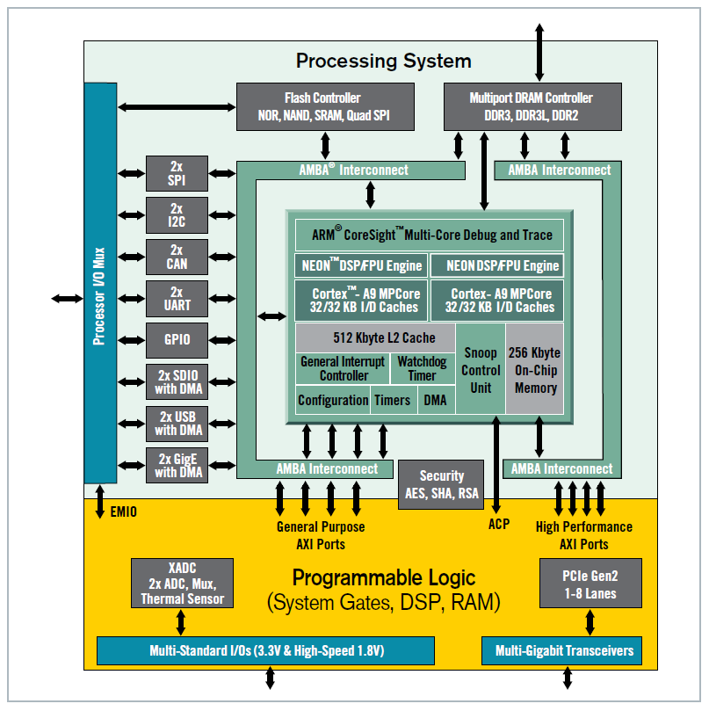
Example: Xilinx Zynq-7000
Dual-core Arm Cortex-A9 processor
On-chip memory
Memory interfaces
Integrated peripherals: timers, USB, UART, I2C, SPI
AXI buses and AXI ports
Programmable logic
Picture source: http://www.xilinx.com/publications/prod_mktg/zynq-7000-generation-ahead-backgrounder.pdf
Notes:
The Processing System of a Xilinx Zynq-7000 Programmable SoC is built around a dual-core Arm Cortex-A9 processor and includes:
An Application processing unit, which is the Arm Cortex-A9 itself
I/O peripherals
Memory interfaces
Processing System interconnect based on Arm AMBA AXI
DMA
Timers
General interrupt controller
On-chip memory
On-chip debug hardware, which is the Arm CoreSight Debug and Trace
The Programmable Logic shares the same 7 series programmable logic as some of the Xilinx Artix and Kintex-based devices.

Slide 26
Design a Simple Arm-based SoC
Design Arm-based SoCs and prototype them onto a Zynq chip.
The SoCs will consist of:
An Arm Cortex-A9 microprocessor
An AXI bus
Different customer-made physical IPs
Arm Cortex-A9
Microprocessor
ARM AMBA 3 AHB-Lite System Bus
Arm AMBA 4 AXI System Bus
DDR RAM
System
Control
UART
ROM
GPIO
Boot
ROM
RAM
HDMI input
ROM
Table
HDMI output
AHB
Peripheral
…
A simplified Arm-based SoC
Notes:
In this course, we will design a simplified version of an Arm-based SoC and prototype it onto a Zynq chip.
We will learn how to implement customized Arm-based SoCs on programmable devices by developing both the software and the hardware partitions required to realize a complete SoC.

